Slide 1
Unit 2
S-7 | SLO-1 | PMOS,NMOS
 | SLO-2 | CMOS Logic

Slide 2
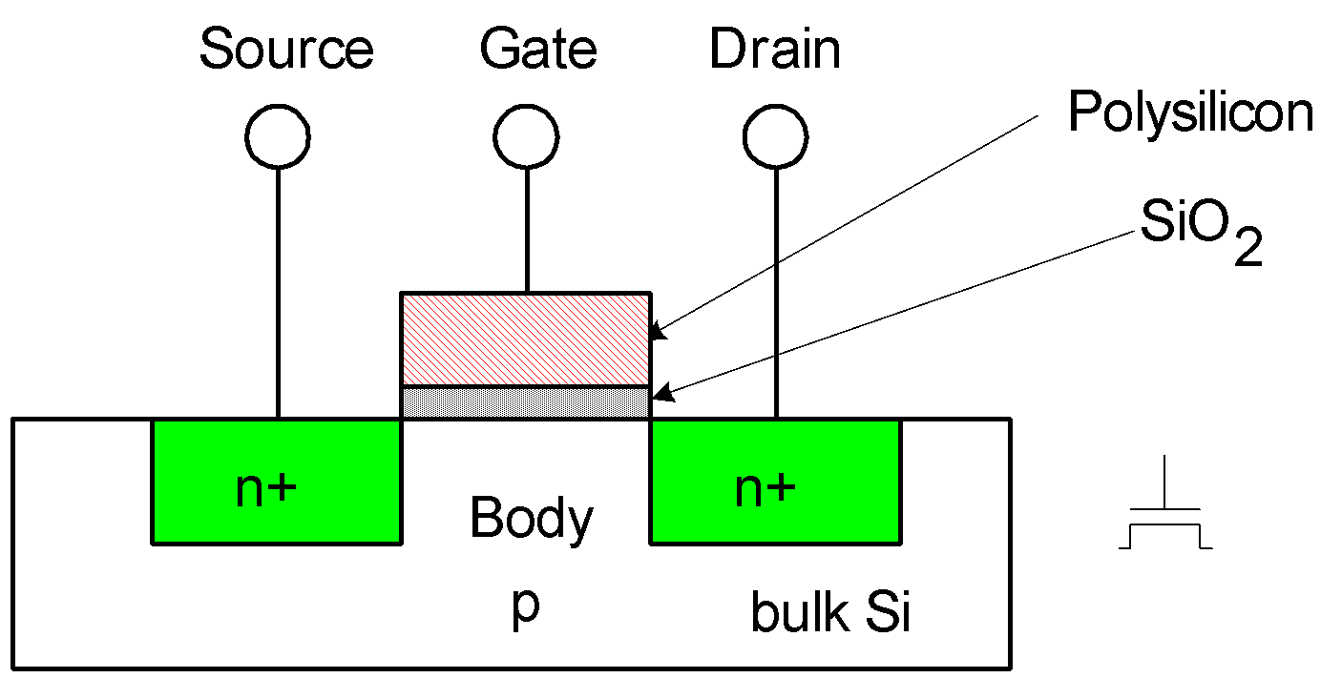
nMOS Transistor
Four terminals: gate, source, drain, body
Gate – oxide – body stack looks like a capacitor
Gate and body are conductors
SiO₂ (oxide) is a very good insulator
Called metal – oxide – semiconductor (MOS) capacitor
Even though gate is
no longer made of metal

Slide 3
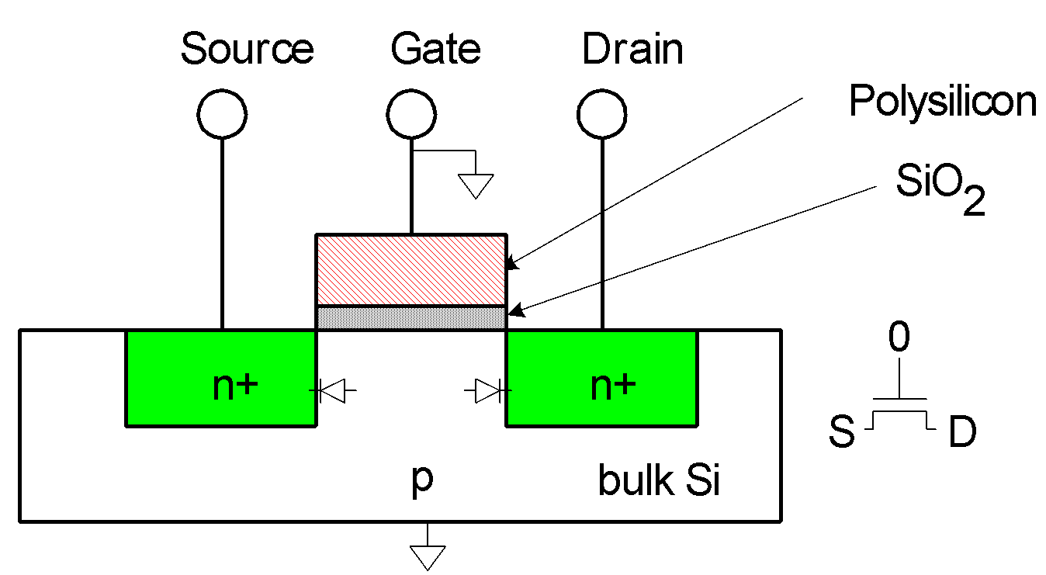
nMOS Operation
Body is usually tied to ground (0 V)
When the gate is at a low voltage:
P-type body is at low voltage
Source-body and drain-body diodes are OFF
No current flows, transistor is OFF

Slide 4

nMOS Operation Cont.
When the gate is at a high voltage:
Positive charge on gate of MOS capacitor
Negative charge attracted to body
Inverts a channel under gate to n-type
Now current can flow through n-type silicon from source through channel to drain, transistor is ON

Slide 5
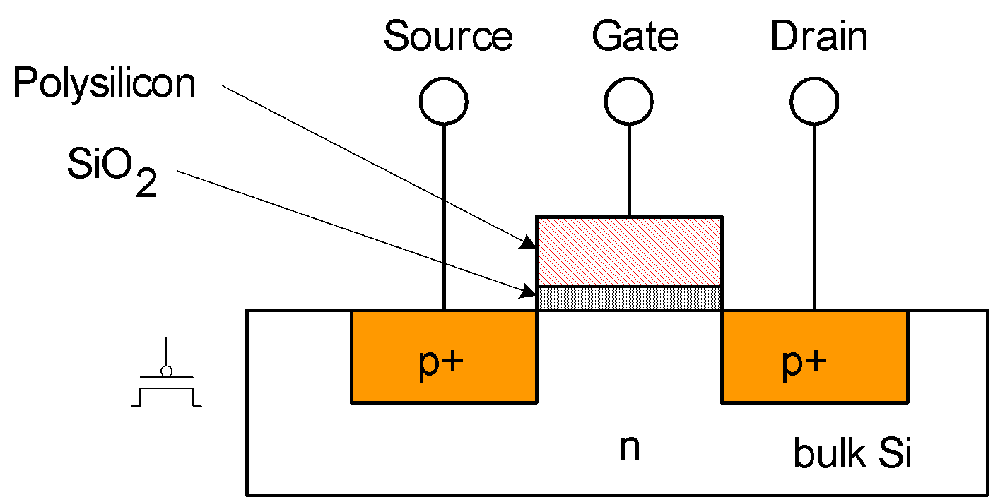
pMOS Transistor
Similar, but doping and voltages reversed
Body tied to high voltage (V_{DD})
Gate low: transistor ON
Gate high: transistor OFF
Bubble indicates inverted behavior

Slide 6
Power Supply Voltage
GND = 0 V
In 1980’s, V_{DD} = 5V
V_{DD} has decreased in modern processes
High V_{DD} would damage modern tiny transistors
Lower V_{DD} saves power
V_{DD} = 3.3, 2.5, 1.8, 1.5, 1.2, 1.0, …

Slide 7
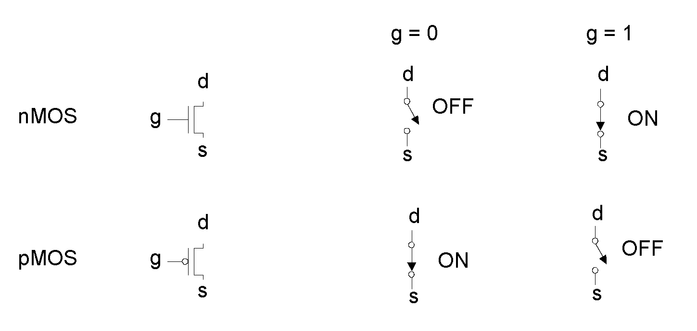
Transistors as Switches
We can view MOS transistors as electrically controlled switches
Voltage at gate controls path from source to drain

Slide 8
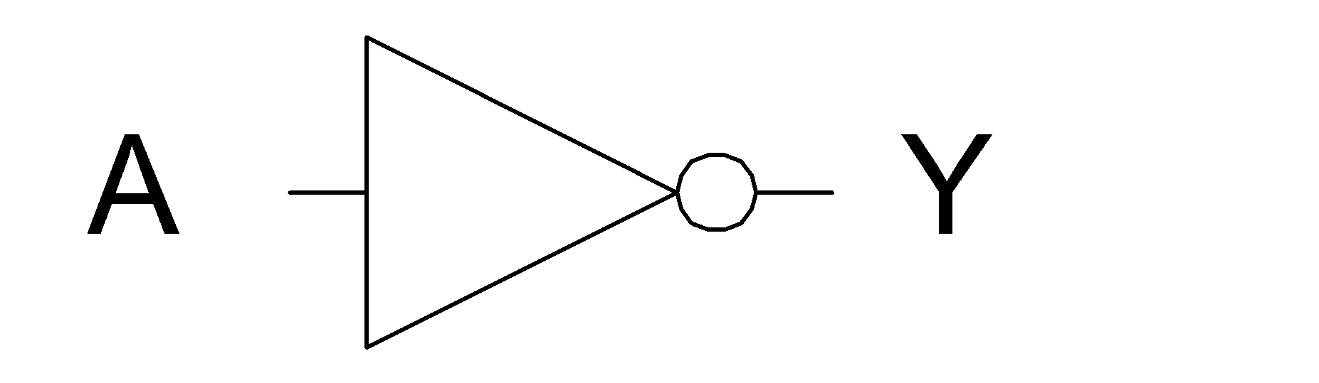
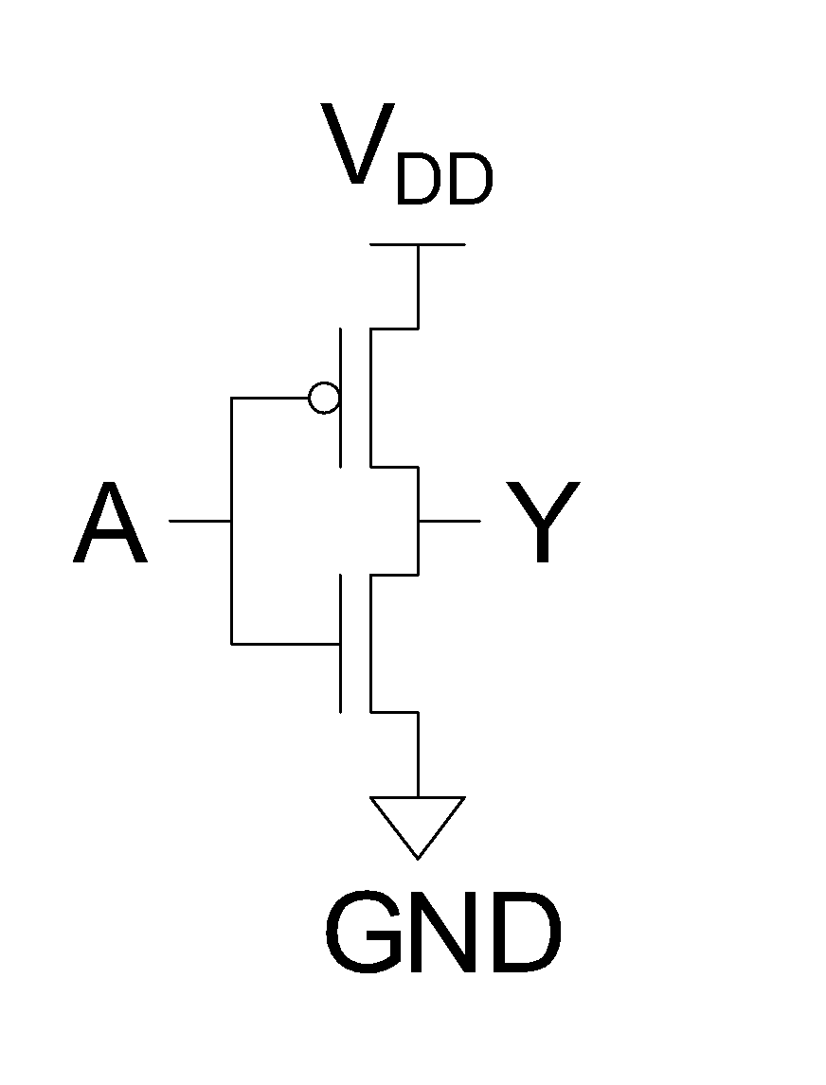
CMOS Inverter
A | Y
0 | 1
1 | 0
OFF
ON
0
1
ON
OFF

Slide 9
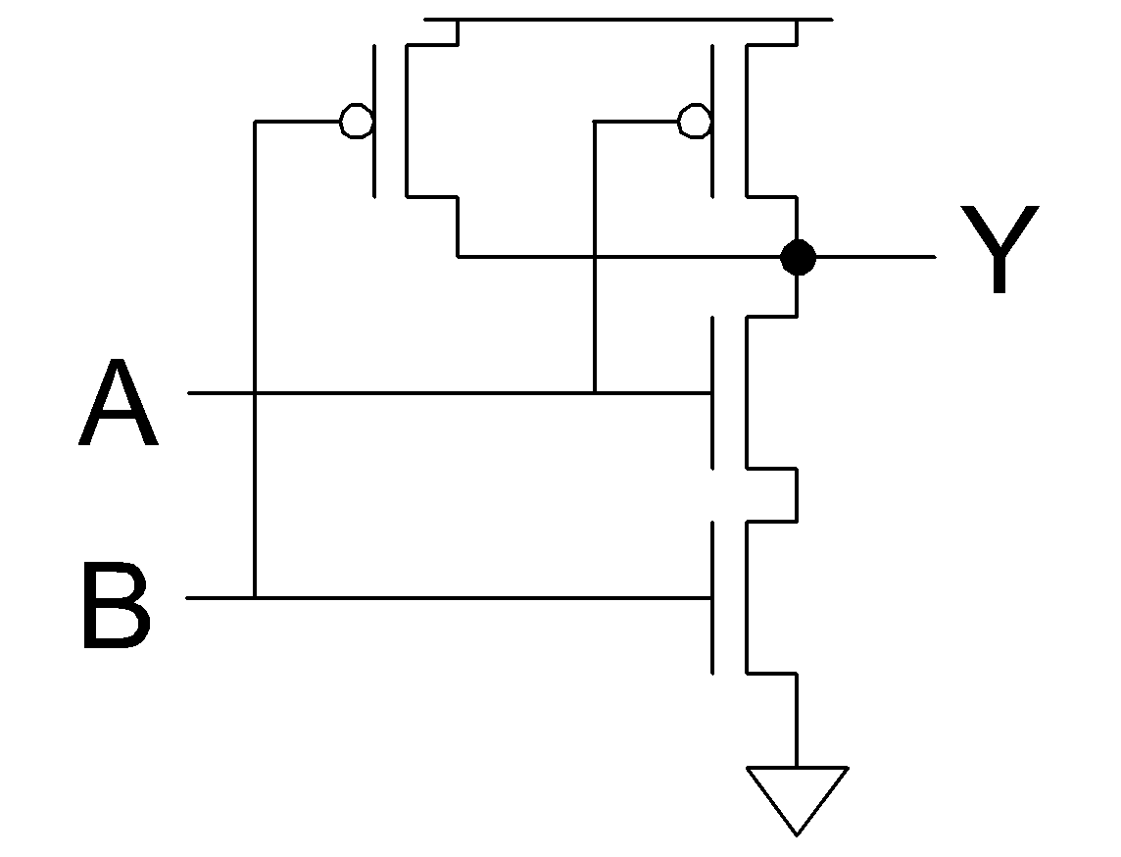
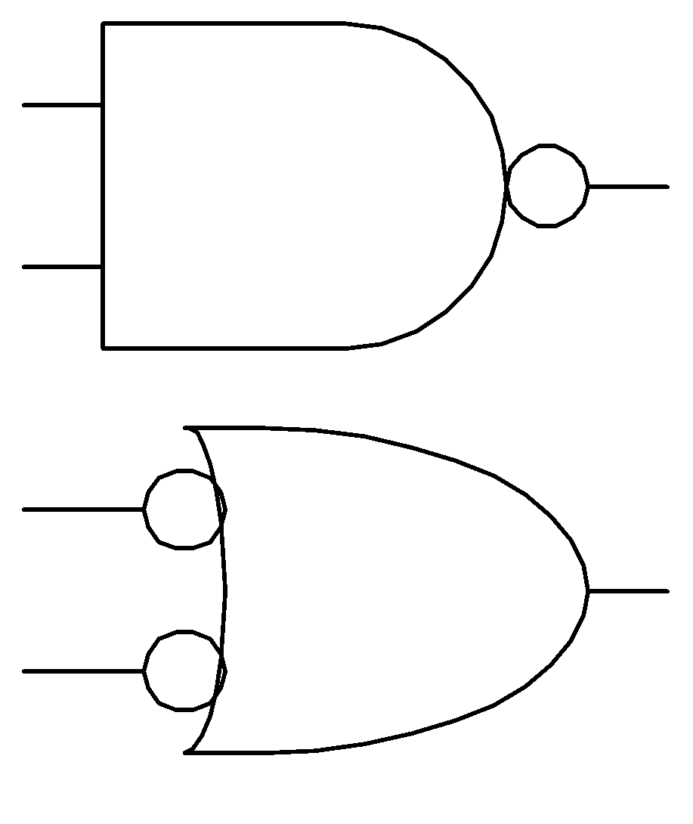
CMOS NAND Gate
A | B | Y
0 | 0 | 1
0 | 1 | 1
1 | 0 | 1
1 | 1 | 0
OFF
ON
OFF
OFF
OFF
ON
ON
1
ON
1
1
1
0
0
ON
1
ON
OFF
OFF
0
1
0
1
0
ON
OFF
ON
OFF

Slide 10
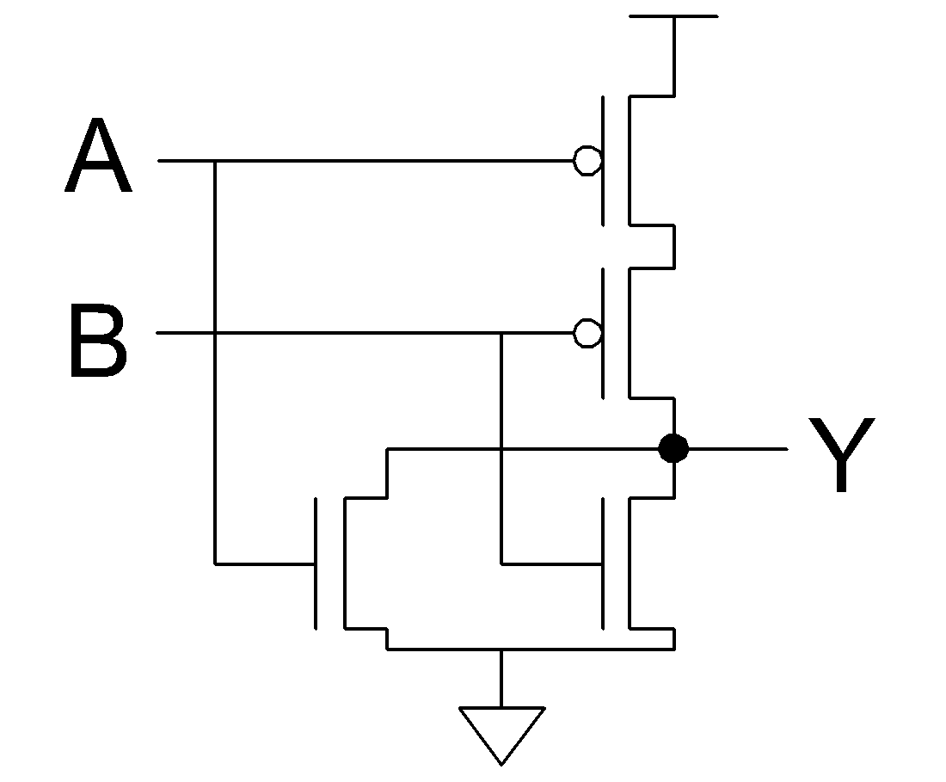
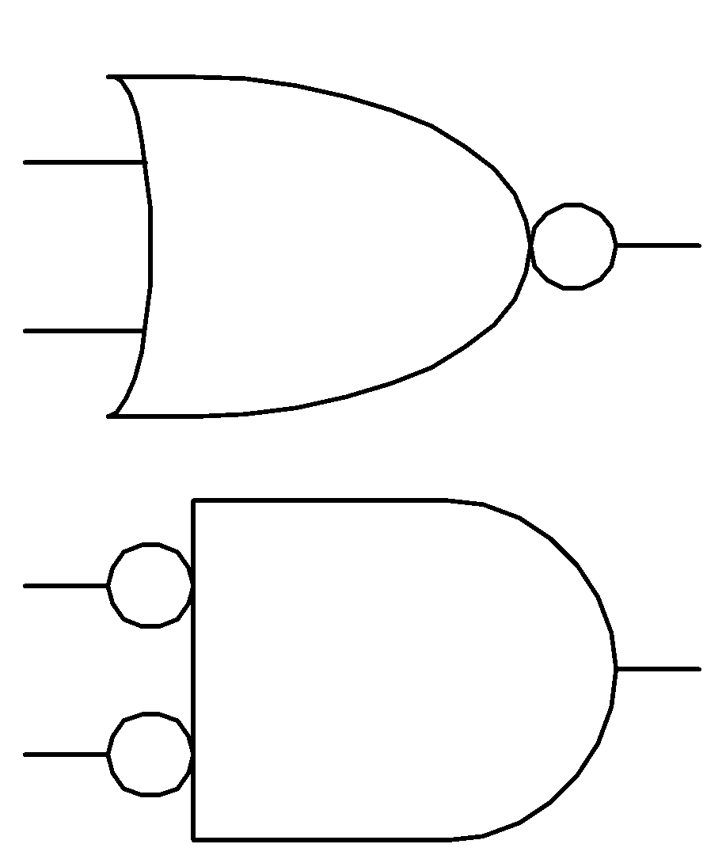
CMOS NOR Gate
A | B | Y
0 | 0 | 1
0 | 1 | 0
1 | 0 | 0
1 | 1 | 0

